Slide 2
Image
Practically every scene around us involves images or image processing.
An image can be defined as a two dimensional signal analog or digital that contains intensity or color information arranged along x and y spatial axis.
It can be defined as a two dimensional function f(x,y) where the x and y are spatial co-ordinates. Here the amplitude of function “ f ” at any pair of co-ordinates (x,y) is called the intensity or gray level or the color of the image at that point.

Slide 3
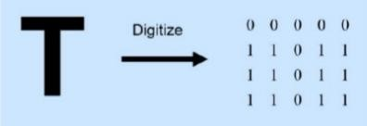
Image Types
There are two types of images, analog and digital.
Simple example, let 1 represent white and 0 represent black color.

Slide 4
Analog Image
Analog image is a two dimensional function of f(s,t) considered in the continuous time domain.
An image can be defined as a two dimensional function f(x,y) where the x and y are spatial co-ordinates. Here the amplitude of function “ f ” at any pair of co-ordinates (x,y) is called the intensity or gray level or the color of the image at that point.
When x, y and the amplitude values of f are continuous quantities then the image is referred as analog image.

Slide 5
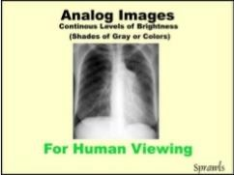
Analog images are the type of images that we, as humans, look at. They also include such things as photographs, paintings, TV images, and all of our medical images recorded on film or displayed on various display devices.
What we see in an analog image is various levels of brightness (or film density) and colors. It is generally continuous and not broken into many small individual pieces.
Analog images are required for human viewing.

Slide 6
Digital Image
An image can be defined as a two dimensional function f(x,y) where the x and y are spatial co-ordinates. Here the amplitude of function “ f ” at any pair of co-ordinates (x,y) is called the intensity or gray level or the color of the image at that point.
When x, y and the amplitude values of f are all finite and discrete quantities then the image is referred as digital image. Digital image processing refers to the processing of digital images by means of digital computer.
A digital image is composed of a finite number of elements, each of which has a particular location and value. These elements are referred to as pels, pixels, picture elements or image elements

Slide 7
A digital image is a matrix of many small elements, or pixels.
Each pixel is represented by a numerical value. In general, the pixel value is related to the brightness or color that we will see when the digital image is converted into an analog image for display and viewing

Slide 8
Impact Digital Image
Digital images are necessary in all modern medical imaging methods. Because of the following functions that can be performed with digital images :
1. Image reconstruction (CT, MRI, SPECT, PET, etc)
2. Image reformatting (Multi-plane, multi-view reconstructions)
3. Wide (dynamic) range image data acquisition (CT, digital radiography, etc)
4. Image processing (to change contrast and other quality characteristics)
5. Fast image storage and retrieval
6. Fast and high-quality image distribution (teleradiology)
7. Controlled viewing (windowing, zooming, etc)
8. Image analysis (measurements, calculation of various parameters, computer aided diagonisis)

Slide 9
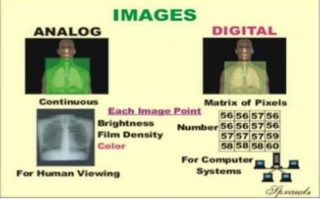
Analog VS Digital Image

Slide 10
Image Processing
Some people consider that image processing is a discipline in which both the input and output of a process are images. According to this definition computing average intensity of an image would not be considered as image processing task. However there is no such limitations or boundaries for image processing.
However, one useful paradigm is to consider three types of computerized processes in this continuum: 1. low-level image processing 2. mid-level image processing and 3. high-level image processing

Slide 11
Level of Image Processing
A low-level process is characterized by the fact that both its inputs and outputs are images such as image preprocessing to reduce noise, contrast enhancement, and image sharpening.
A mid-level process is characterized by the fact that its inputs generally are images, but its outputs are attributes extracted from those images. Such as segmentation (partitioning an image into regions or objects).
A high-level process is characterized by the fact that its inputs generally are attributes extracted from images, but its outputs are images. higher-level processing involves an ensemble of recognized objects, as in image analysis

Slide 12
Origins of Digital Image Processing
One of the first applications of digital images was in the newspaper industry, when pictures were first sent by submarine cable between London and New York.
Introduction of the Bartlane cable picture transmission system in the early 1920s reduced the time required to transport a picture across the Atlantic from more than a week to less than three hours.
Specialized printing equipment was used to code pictures for transmitting it via cable and then reconstruct the image from the codes at the receiving end

Slide 13
Digital Image Processing
Digital image processing can be defined as processing of digital image in a digital manner meaning that using a digital device like computer or others.
The digital image processing is getting more and more importance now a days because of its two major application areas:
1. Improvement of pictorial information for human interpretation.
2. Processing of image data for storage, transmission and representation for autonomous machine perception

Slide 14
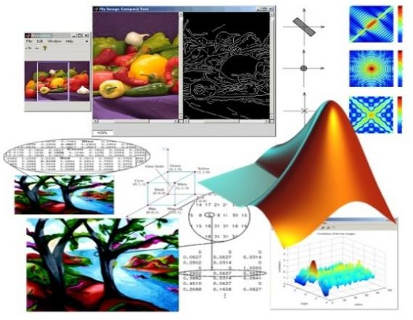

Slide 15
Advantages of DIP
1. It improves the visual quality of an image and the distribution of intensity.
2. It can easily process an degraded image of uncoverable objects
3. It can process an image in such a way that the result is more suitable than the original image
4. An image can be easily modified using a number of techniques
5. The image compression technique reduces the amount of data required to represent a digital image.
6. Mathematical and logical operations can be performed on an image like addition subtraction, OR etc
7. The image segmentation is used to detect discontinuity, the presence or absence of specific anomalies like missing components or broken connection path.

Slide 16
Limitations of DIP
1. Digital image processing requires so much storage and processing power. Progress in the field of digital image processing is dependant on the development of digital computers and supporting technology including data storage, display and transmission
2. Effect of environmental conditions may degrade the image quality
3. It involves various types of redundancy like data redundancy, interpixel redundancy etc
4. Segmentation of nontrivial image is one of the most difficult task in digital image processing

Slide 17
Fields that Use Digital Image Processing
Unlike humans, who are limited to the visual band of the electromagnetic (EM) spectrum, imaging machines cover almost the entire EM spectrum, ranging from gamma to radio waves. They can operate on images generated by sources that humans are not accustomed to associating with images.
Gamma ray imaging
X-ray imaging
Imaging in an ultraviolet band
Imaging in the visible and infrared bands
Imaging in the microwave band
Imaging in the radio band

Slide 18
Gamma ray imaging : imaging based on gamma rays include nuclear medicine and astronomical observations.
PET : another major modality of nuclear imaging is positron emission tomography.

Slide 19
X-ray imaging : X-rays are the oldest sources of EM radiation used for imaging. In digital radiography, digital images are obtained by one of the two methods:
1. By digitizing x-ray films
2. By having the x-rays that pass through the patient and fall onto a device such as phosphor screen that convert x- rays into light
Imaging in the ultraviolet band : the major application of imaging in ultraviolet band includes lithography, industrial inspection, microscopy, lasers, biological imaging and astronomical observations.

Slide 20
Imaging in the visible and infrared bands : the infrared band is used in conjunction with visual imaging. Another major area of visual processing is remote sensing
Imaging in the microwave band : the major application of imaging in the microwave band is radar.
Imaging in the radio band : the major application of imaging in the radio band include medicine and astronomy.

Slide 21
Ultrasound Image
The ultrasound imaging is used to determine the development of health and to determine the sex of unborn babies in the womb. Ultrasound images are generated using the following procedure:
1. The ultrasound system transmits a high frequency sound pulse into the body usually 1 to 5 MHz
2. The sound wave travel through the body and hit a boundary between tissues.
3. Some of the waves are reflected back to the probe and relayed to the computer.
4. The machine calculates the distance from probe to the tissue boundaries by
using the speed of the sound and the time required for each echo’s to return.
5. The system displays the distances and intensities of the echoes on the screen, forming a two dimensional image

Slide 22
Transmission electron microscopy (TEM)
Transmission electron microscopy (TEM) is a microscopy technique in
which a beam of electrons is transmitted through an ultra-thin specimen, interacting with the specimen as it passes through.
An image is formed from the interaction of the electrons transmitted through the specimen.
The image is magnified and focused onto an imaging device, such as a fluorescent screen, on a layer of photographic film
Or to be detected by a sensor such as a CCD camera.
TEMs are capable of imaging at a significantly higher resolution than light
microscopes. TEMs find application in cancer research, virology, materials
science as well as pollution, nanotechnology, and semiconductor research. Transmission Electron Microscopy

Slide 23
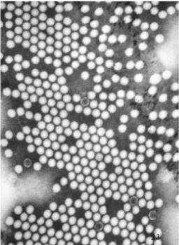
A TEM image of the polio virus. The polio virus is 30 nm in size

Slide 24
Scanning electron microscope (SEM)
A scanning electron microscope (SEM) is a type of electron microscope that produces images of a sample by scanning it with a focused beam of electrons.
SEM can achieve resolution better than 1 nanometer. Specimens can be observed in high vacuum, in low vacuum, in wet conditions (in environmental SEM), and at a wide range of cryogenic or elevated temperatures. Scanning electron microscope

Slide 25
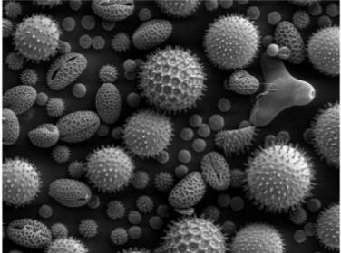
These pollen grains taken on an SEM show the characteristic depth of field of SEM micrographs

Slide 26
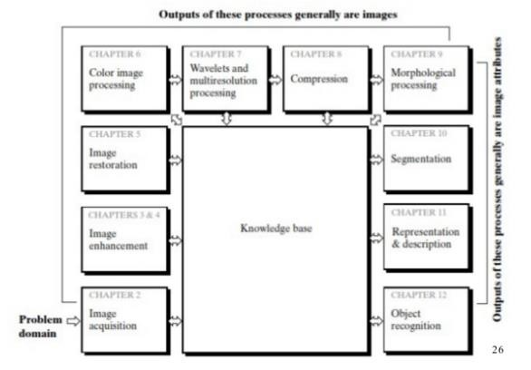
Fundamental Steps in DIP

Slide 27
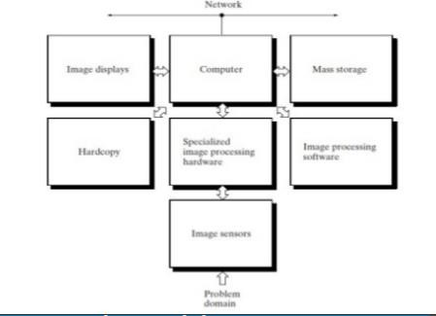
Components of Image Processing System
Following figure shows the basic components comprising a typical general-purpose system used for digital image processing

Slide 28
Components of the System
Image Sensor: With reference to sensing, two elements are required to acquire digital images: a sensor and a digitizer.
Specialized image processing hardware: usually consists of the digitizer just mentioned, plus hardware that performs other primitive operations, such as an arithmetic logic unit (ALU).

Slide 29
Computer: in an image processing system is a general-purpose computer and can range from a PC to a supercomputer.
Software: for image processing consists of specialized modules that
perform specific tasks
Mass storage: capability is a must in image processing applications. Digital storage for image processing applications falls into three principal categories: (1) short-term storage for use during processing, (2) on-line storage for relatively fast recall, and (3) archival storage, characterized by infrequent access.
Image display: it displays images.
Hardcopy devices: used for recording images include laser printers, film cameras, heat-sensitive devices, inkjet units, and digital units, such as optical and CD-ROM disks.

Slide 30
References
Digital Image Processing (3rd Edition): Rafael C. Gonzalez

